Slide 1
P589-1 TCrs – first look
Thomas H. Edwards
20240828

Slide 2
Cells passing qc for each hashtag
hashtag | pool | donorId | stimulation | nCells_passQC
CerosalettiLab1059994_CD3CD28 | 2 | CerosalettiLab1059994 | CD3CD28 | 42
CerosalettiLab1059994_CEFX | 2 | CerosalettiLab1059994 | CEFX | 1437
CerosalettiLab1059994_Islet | 2 | CerosalettiLab1059994 | Islet | 114
CerosalettiLab1464776_CD3CD28 | 2 | CerosalettiLab1464776 | CD3CD28 | 160
CerosalettiLab1464776_CEFX | 2 | CerosalettiLab1464776 | CEFX | 1884
CerosalettiLab1464776_Islet | 2 | CerosalettiLab1464776 | Islet | 153
CerosalettiLab448473_CD3CD28 | 1 | CerosalettiLab448473 | CD3CD28 | 493
CerosalettiLab448473_CEFX | 1 | CerosalettiLab448473 | CEFX | 3111
CerosalettiLab448473_Islet | 1 | CerosalettiLab448473 | Islet | 240
CerosalettiLab632811_CD3CD28 | 1 | CerosalettiLab632811 | CD3CD28 | 604
CerosalettiLab632811_CEFX | 1 | CerosalettiLab632811 | CEFX | 1334
CerosalettiLab632811_Islet | 1 | CerosalettiLab632811 | Islet | 388
CerosalettiLab839987_CD3CD28 | 1 | CerosalettiLab839987 | CD3CD28 | 279
CerosalettiLab839987_CEFX | 1 | CerosalettiLab839987 | CEFX | 8612
CerosalettiLab839987_Islet | 1 | CerosalettiLab839987 | Islet | 263
CerosalettiLab942655_CD3CD28 | 2 | CerosalettiLab942655 | CD3CD28 | 439
CerosalettiLab942655_CEFX | 2 | CerosalettiLab942655 | CEFX | 12609
CerosalettiLab942655_Islet | 2 | CerosalettiLab942655 | Islet | 244
All CEFX hashtags downsampled to 600 cells.

Slide 3
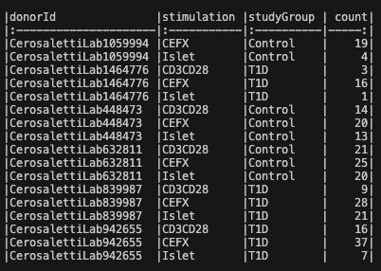
Tcr accounting
DonorIds with missing TCR barcodes:
274 cells in the downsampled population are missing corresponding TCR barcodes
11 doublets identified (>= 3 TRA OR TRB)

Slide 4
Cell proportions with tcr chains per donorid
 | 0 alpha | 1 alpha | 2 alpha
0 beta | 274 (3.9%) | 515 (7.4%) | NA
1 beta | 351 (5.1%) | 5063 (72.8%) | 588 (8.5%)
2 beta | NA | 159 (2.3%) | NA

Slide 5
Tcr detection per donorid by stimulation

Slide 6
Tcr detection per donorid by stimulation/studygroup

Slide 7
11 mait cells, 35 inkt cells identified
 | MAIT | iNKT
Islet | 0 | 24
CEFX | 8 | 7
CD3/CD28 | 3 | 4
HC | 6 (3 donors) | 3 (1 donor, 1059994
T1D | 5 (3 donors) | 32 (1 donor, 839987)

Slide 8
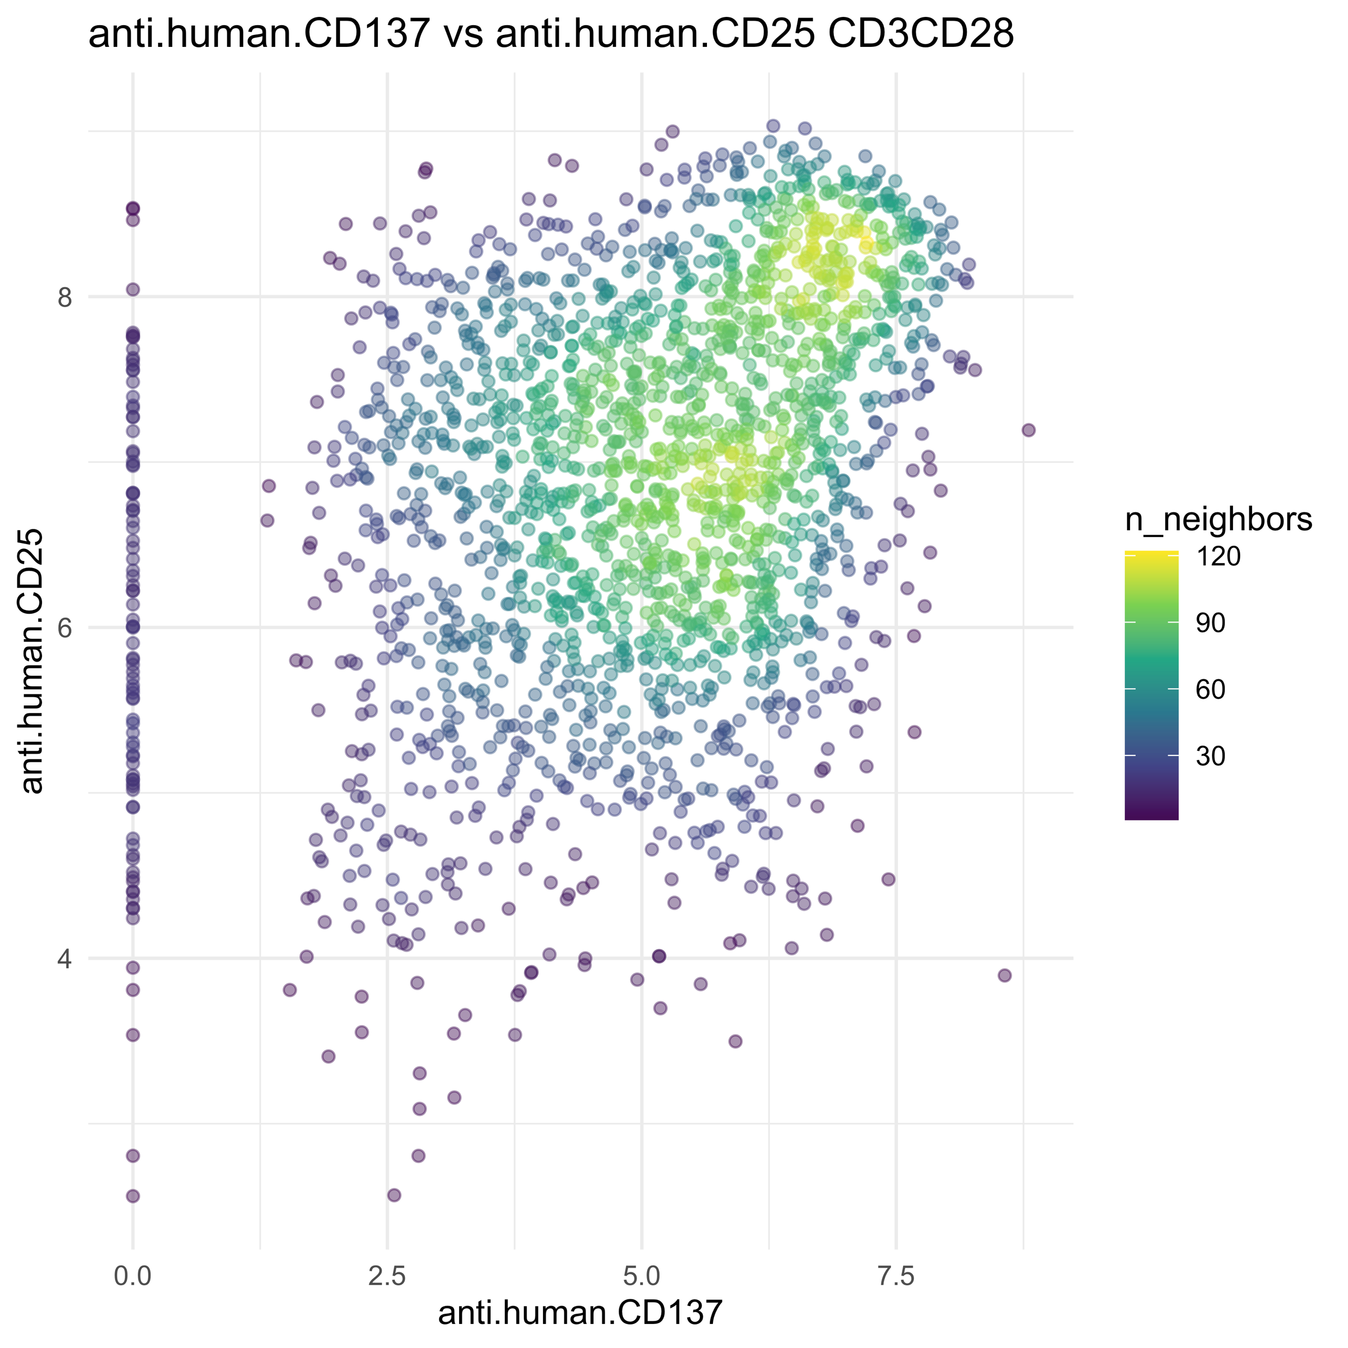
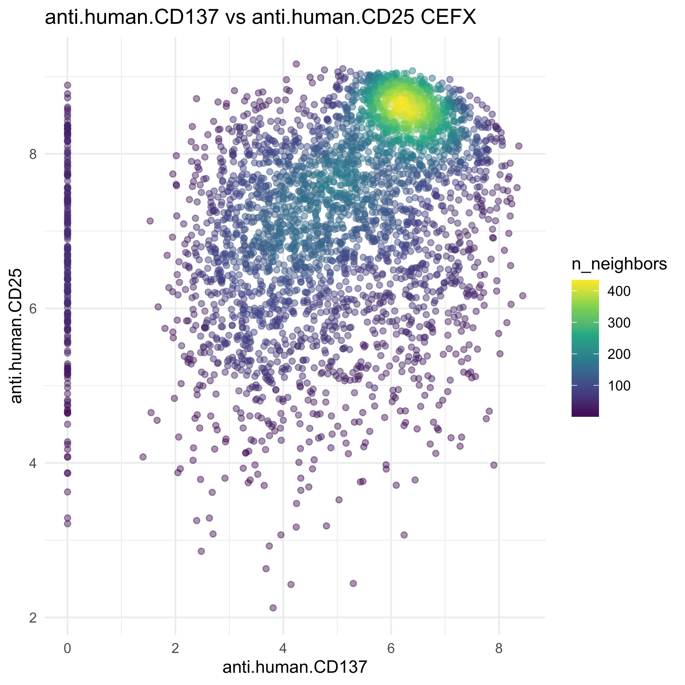
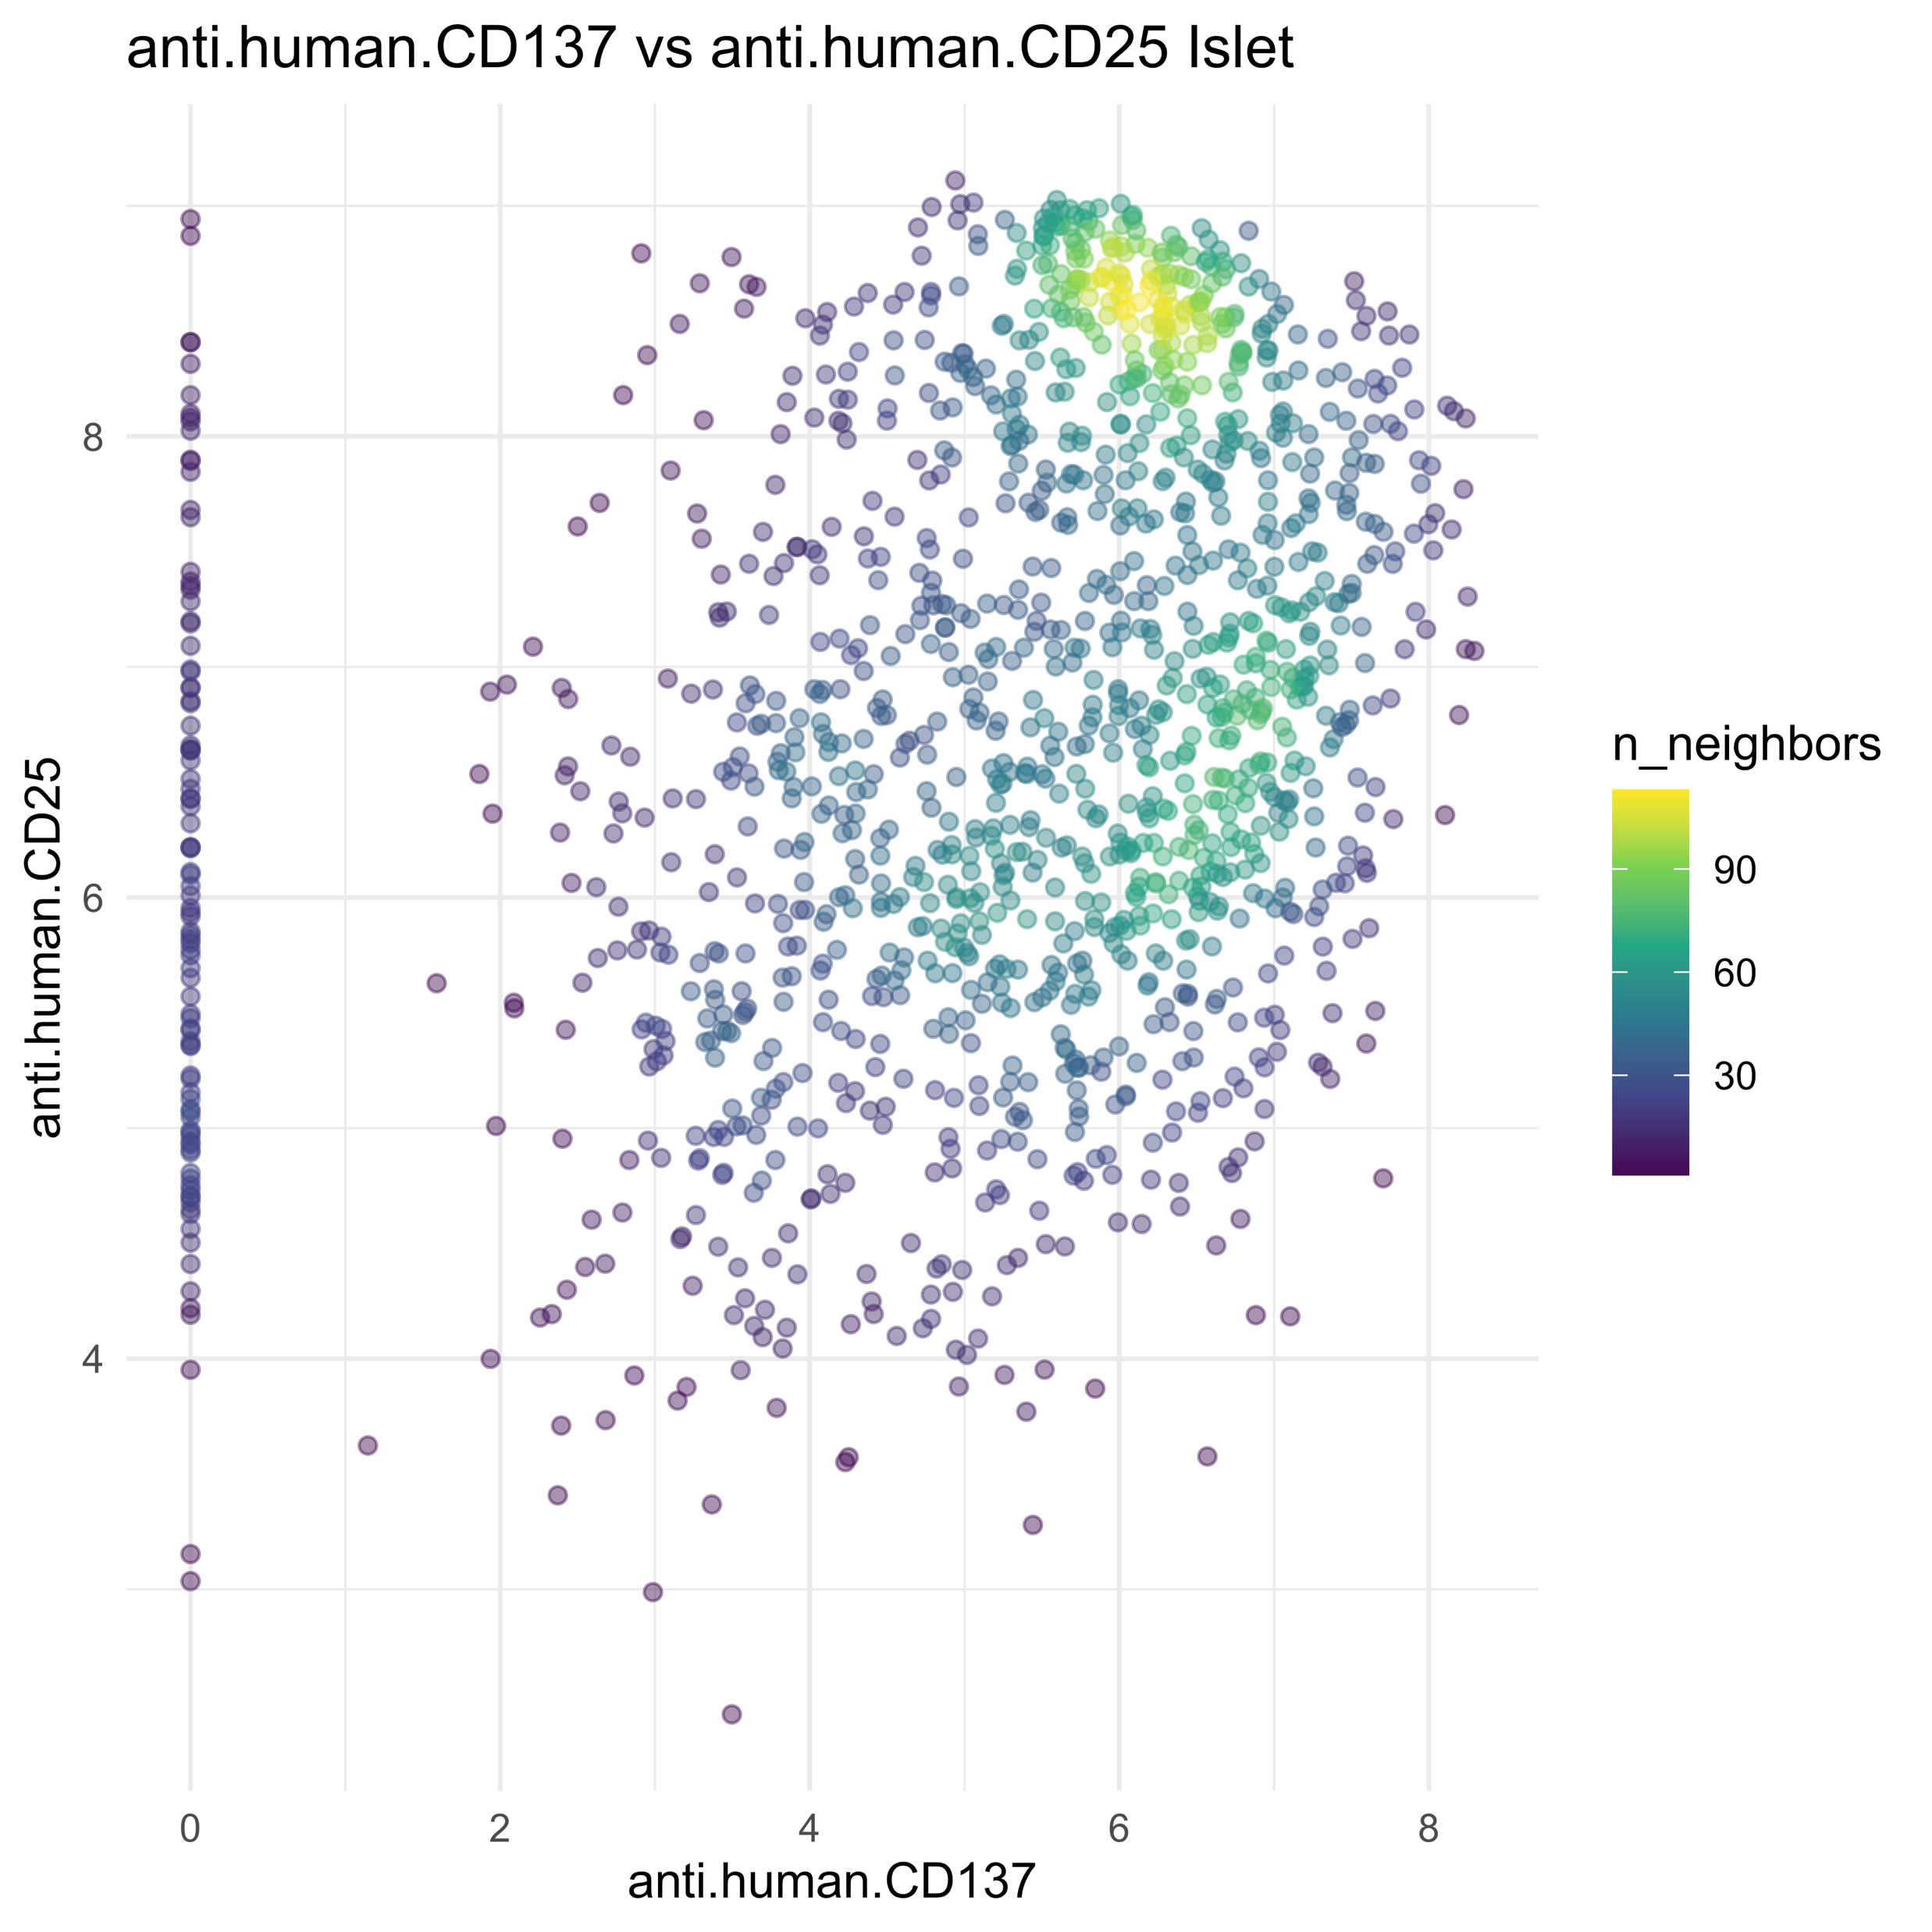
CD25 vs CD137

Slide 9
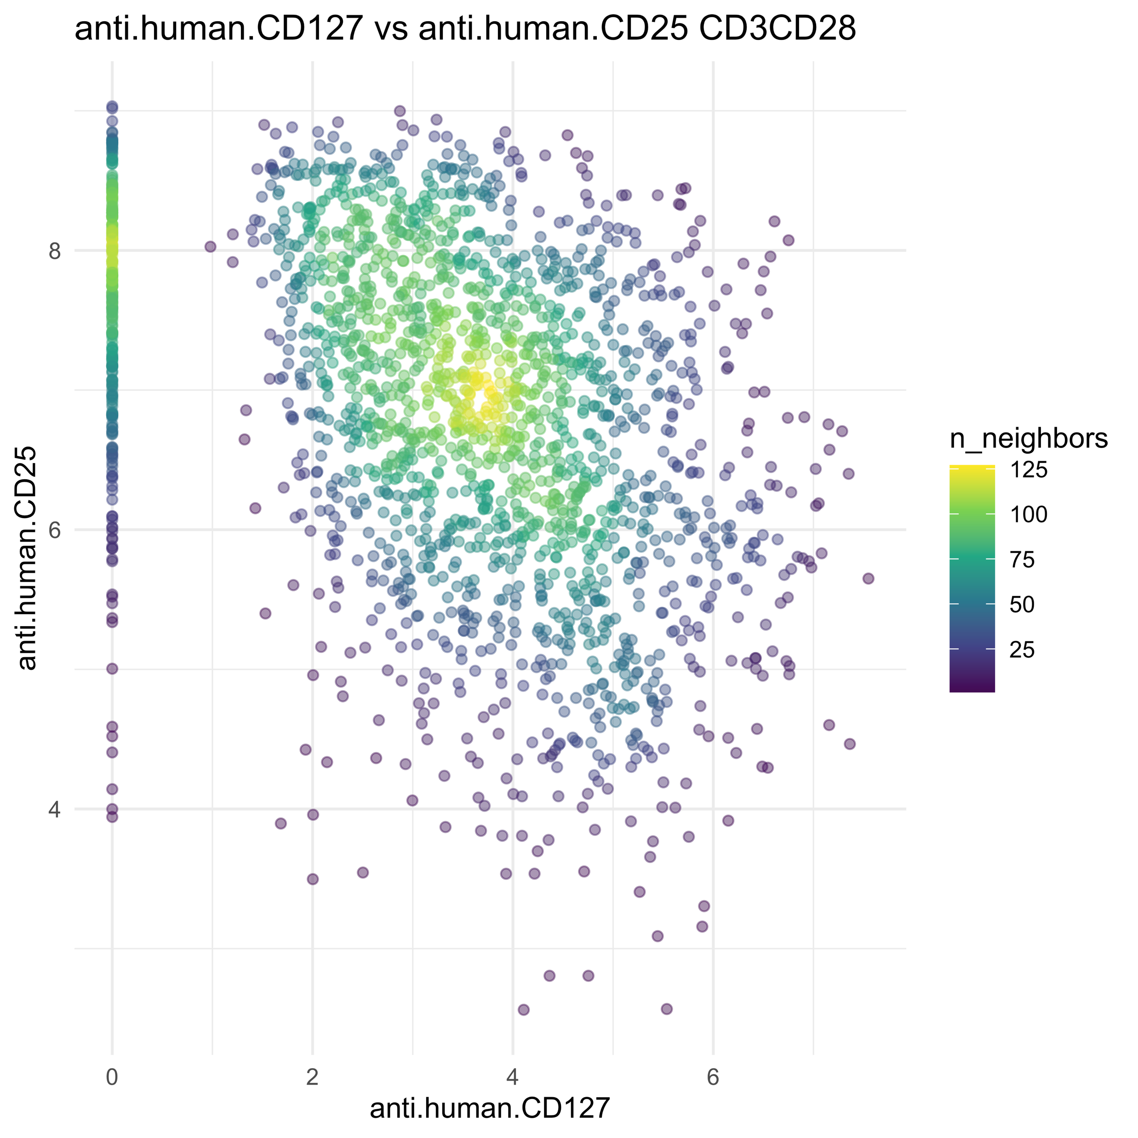
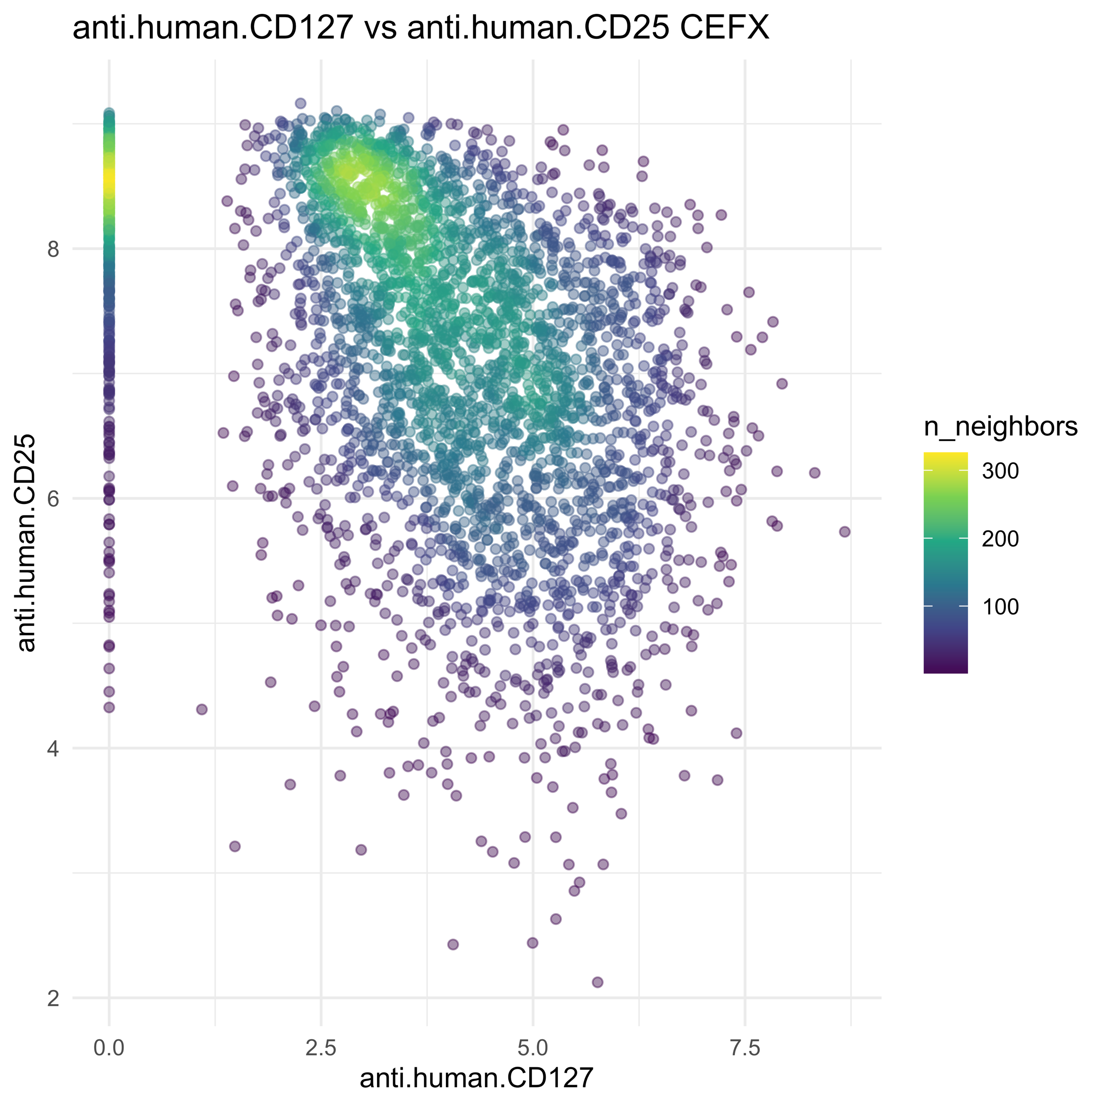
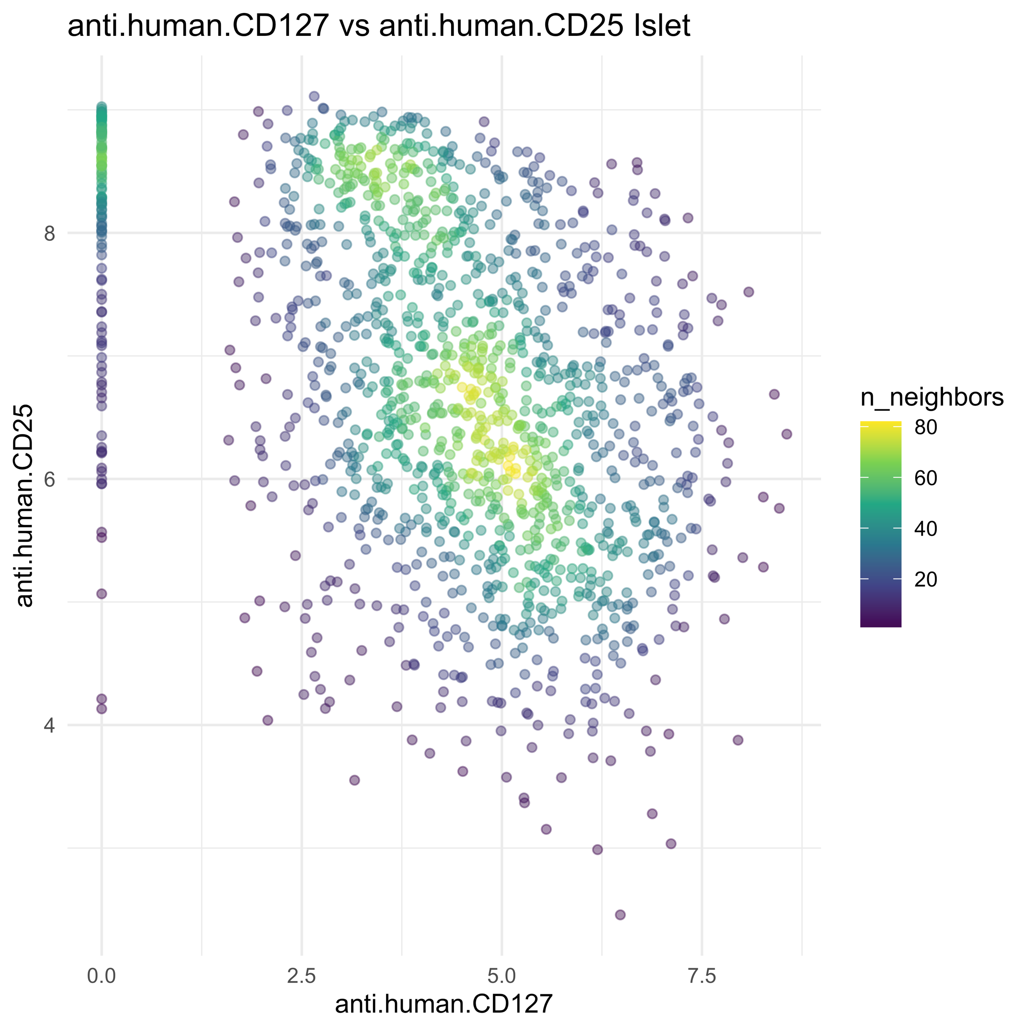
CD25 vs CD127

Slide 10
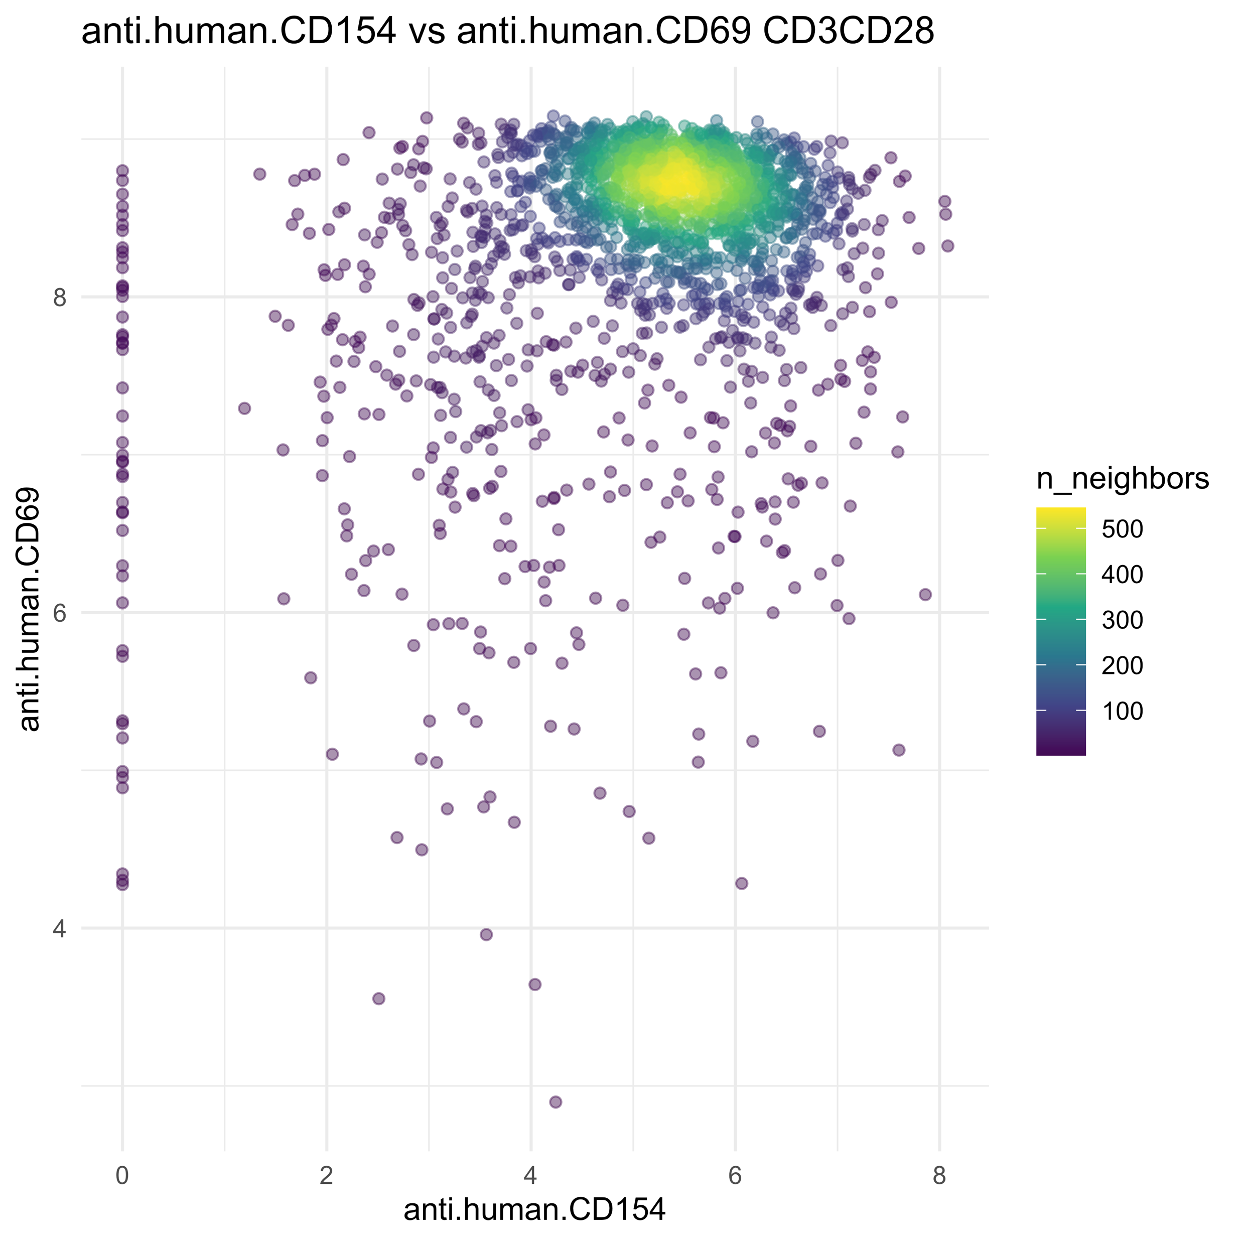
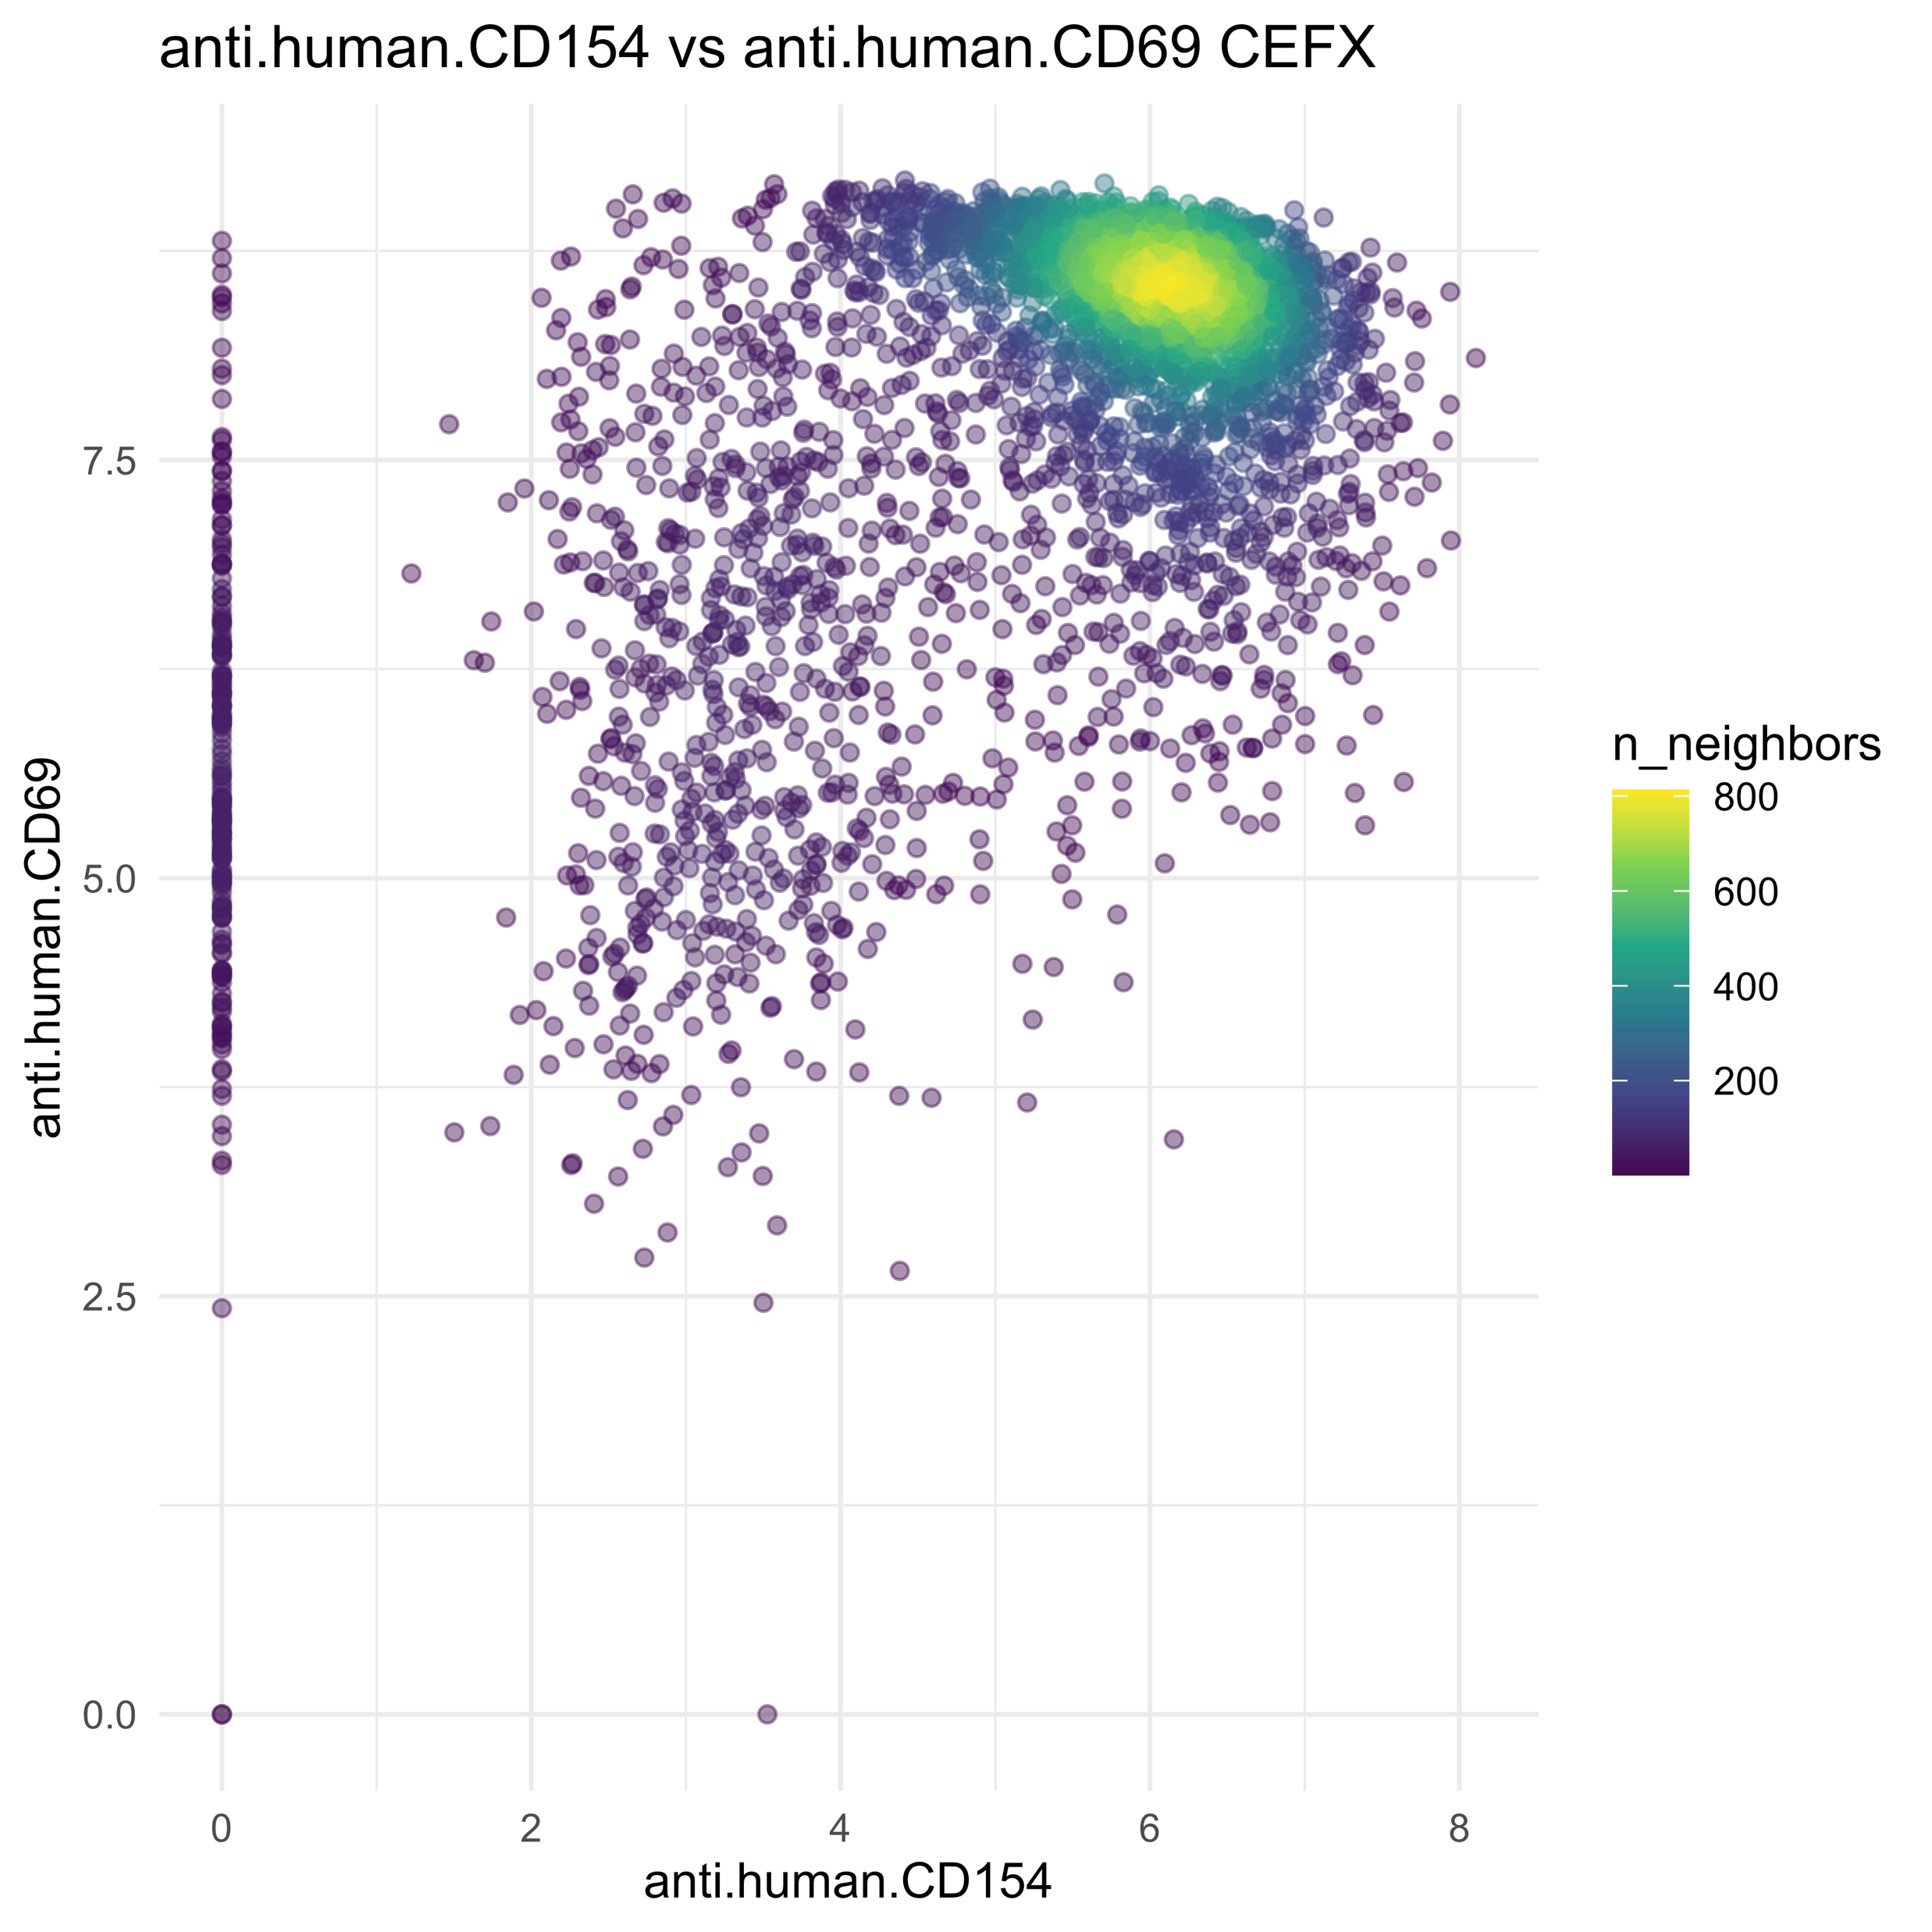
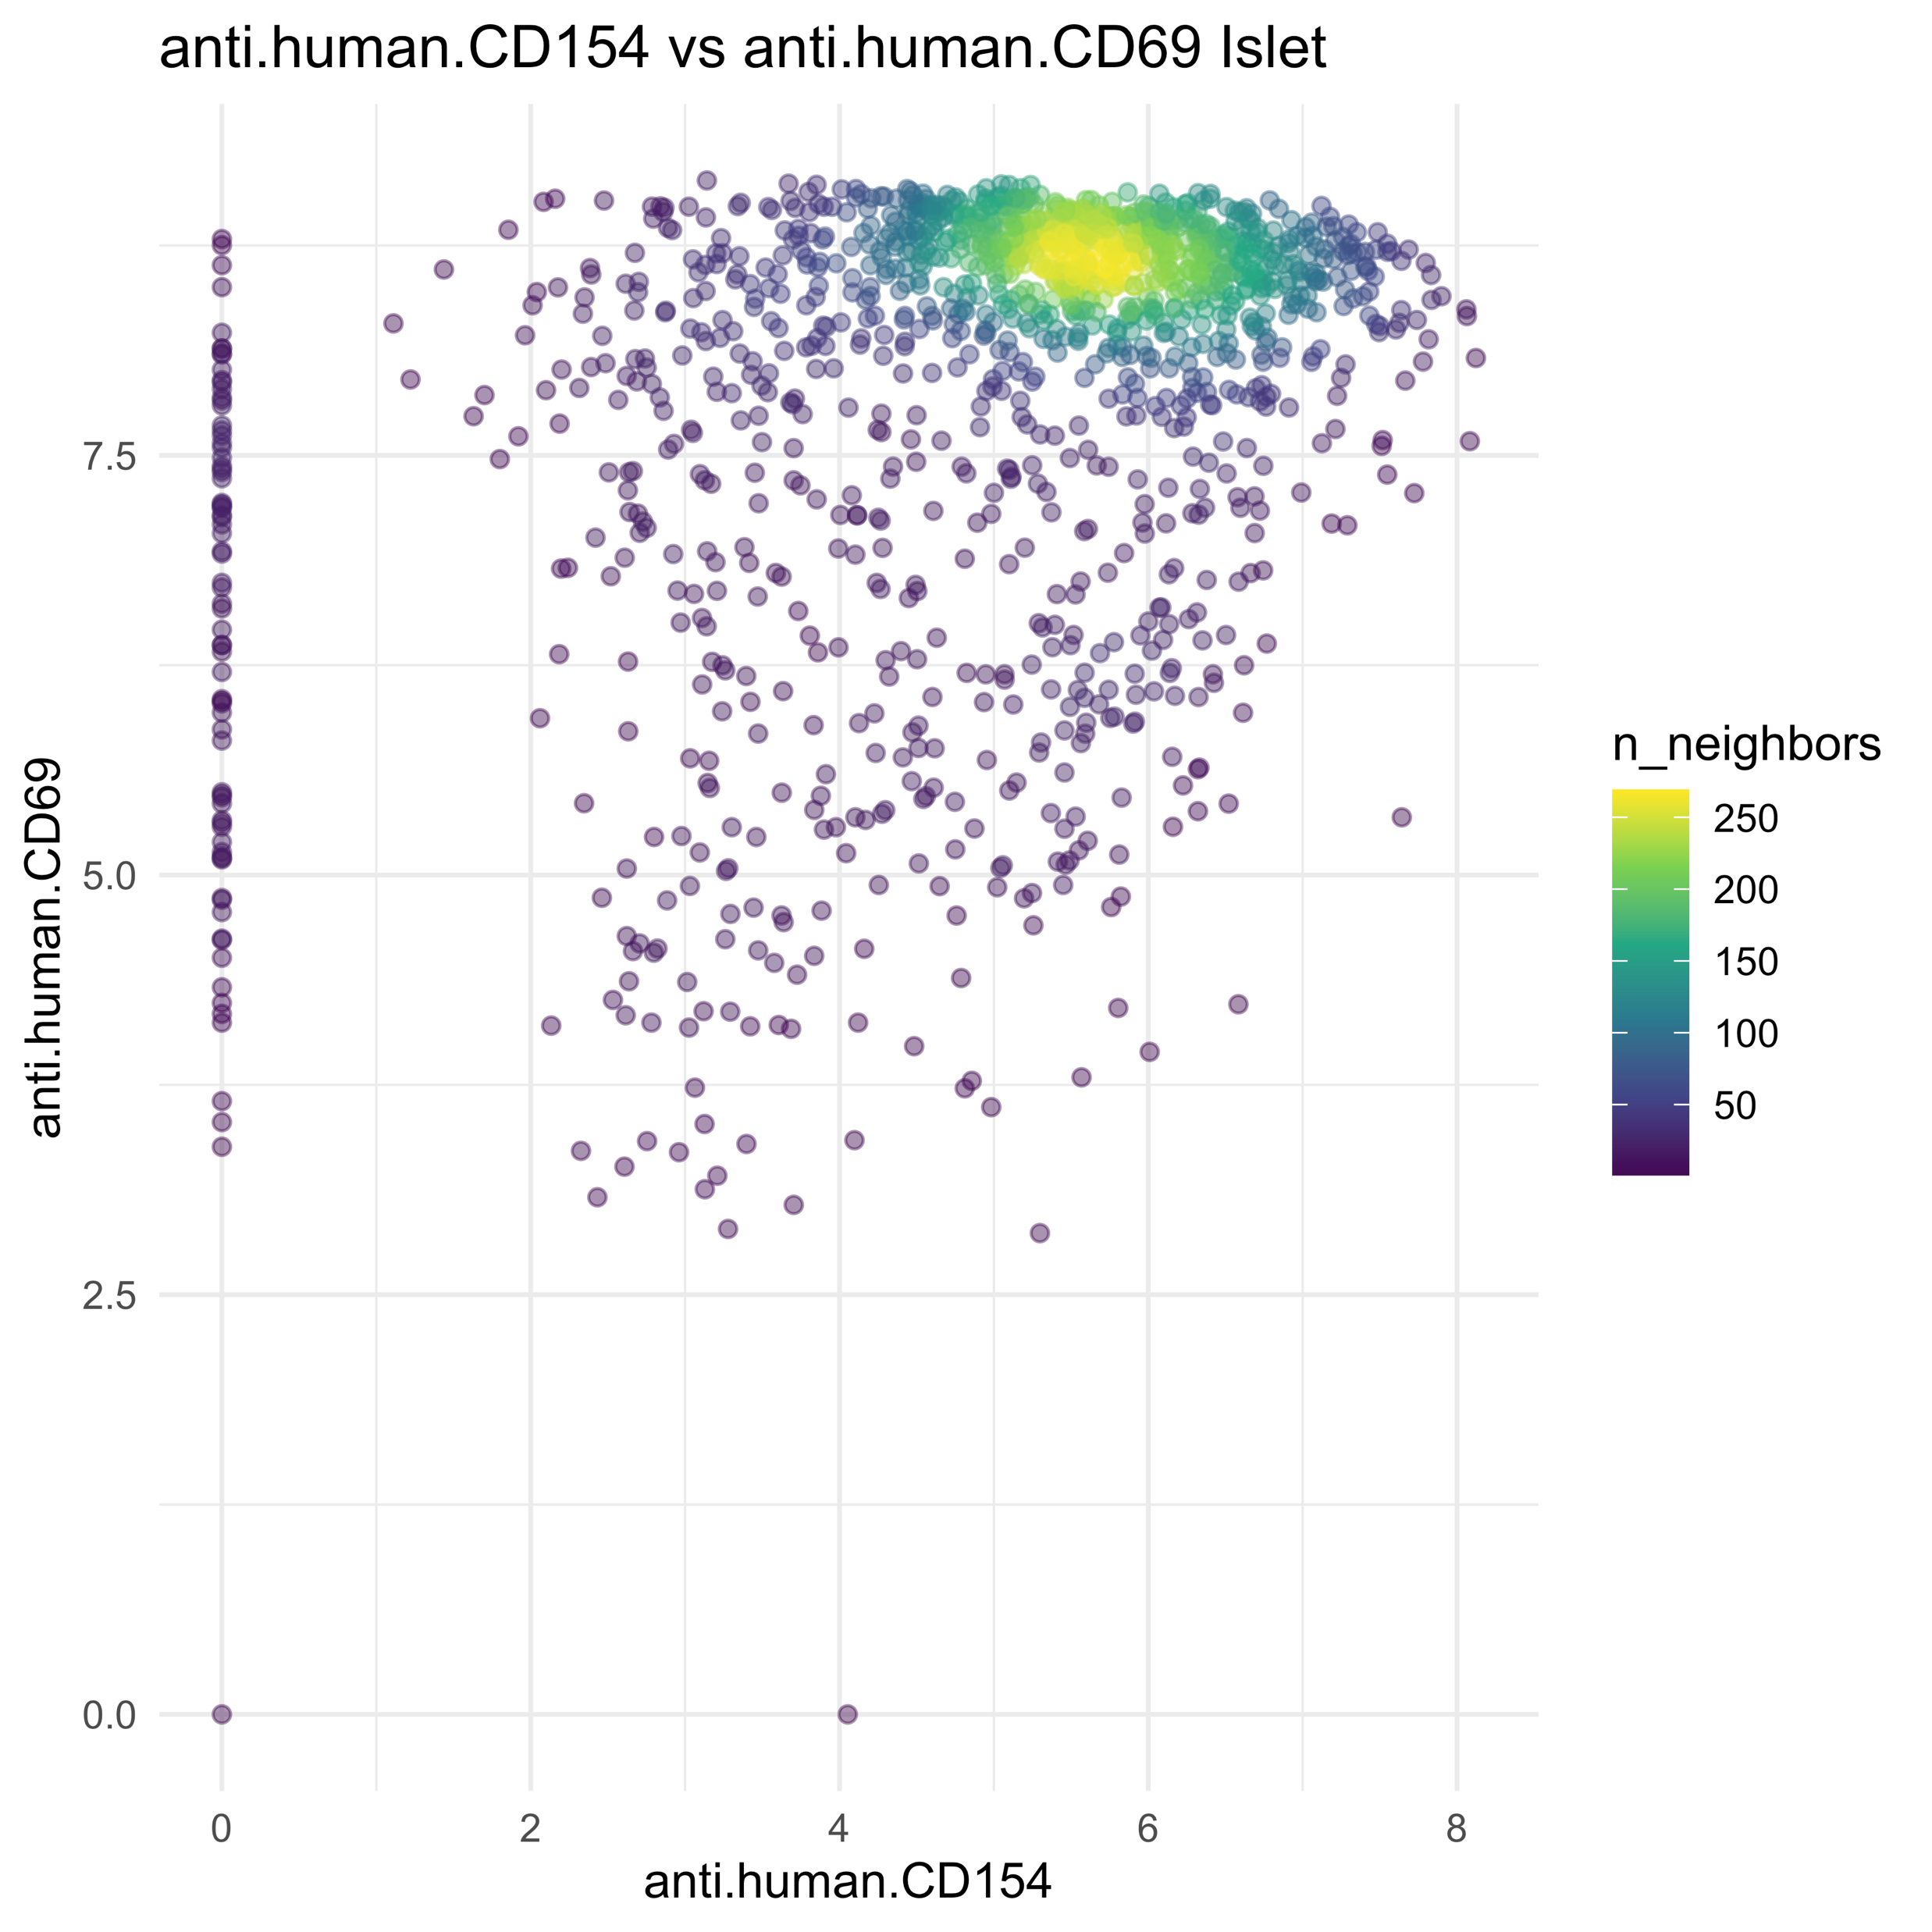
CD69 vs CD154

